Slide 1
Learning with Prototypes
CS771: Introduction to Machine Learning
Nisheeth

Slide 2


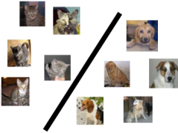





Supervised Learning
Labeled
Training
Data
“dog”
Supervised Learning
Algorithm
“dog”
“cat”
“cat”
Cat vs Dog
Prediction model
“cat”
Predicted Label
(cat/dog)
A test image
Cat vs Dog
Prediction model

Slide 3
Some Types of Supervised Learning Problems
Consider building an ML module for an e-mail client
Some tasks that we may want this module to perform
Predicting whether an email of spam or normal: Binary Classification
Predicting which of the many folders the email should be sent to: Multi-class Classification
Predicting all the relevant tags for an email: Tagging or Multi-label Classification
Predicting what’s the spam-score of an email: Regression
Predicting which email(s) should be shown at the top: Ranking
Predicting which emails are work/study-related emails: One-class Classification
These predictive modeling tasks can be formulated as supervised learning problems
Today: A very simple supervised learning model for binary/multi-class classification
This model doesn’t require any fancy maths – just computing means and distances

Slide 4

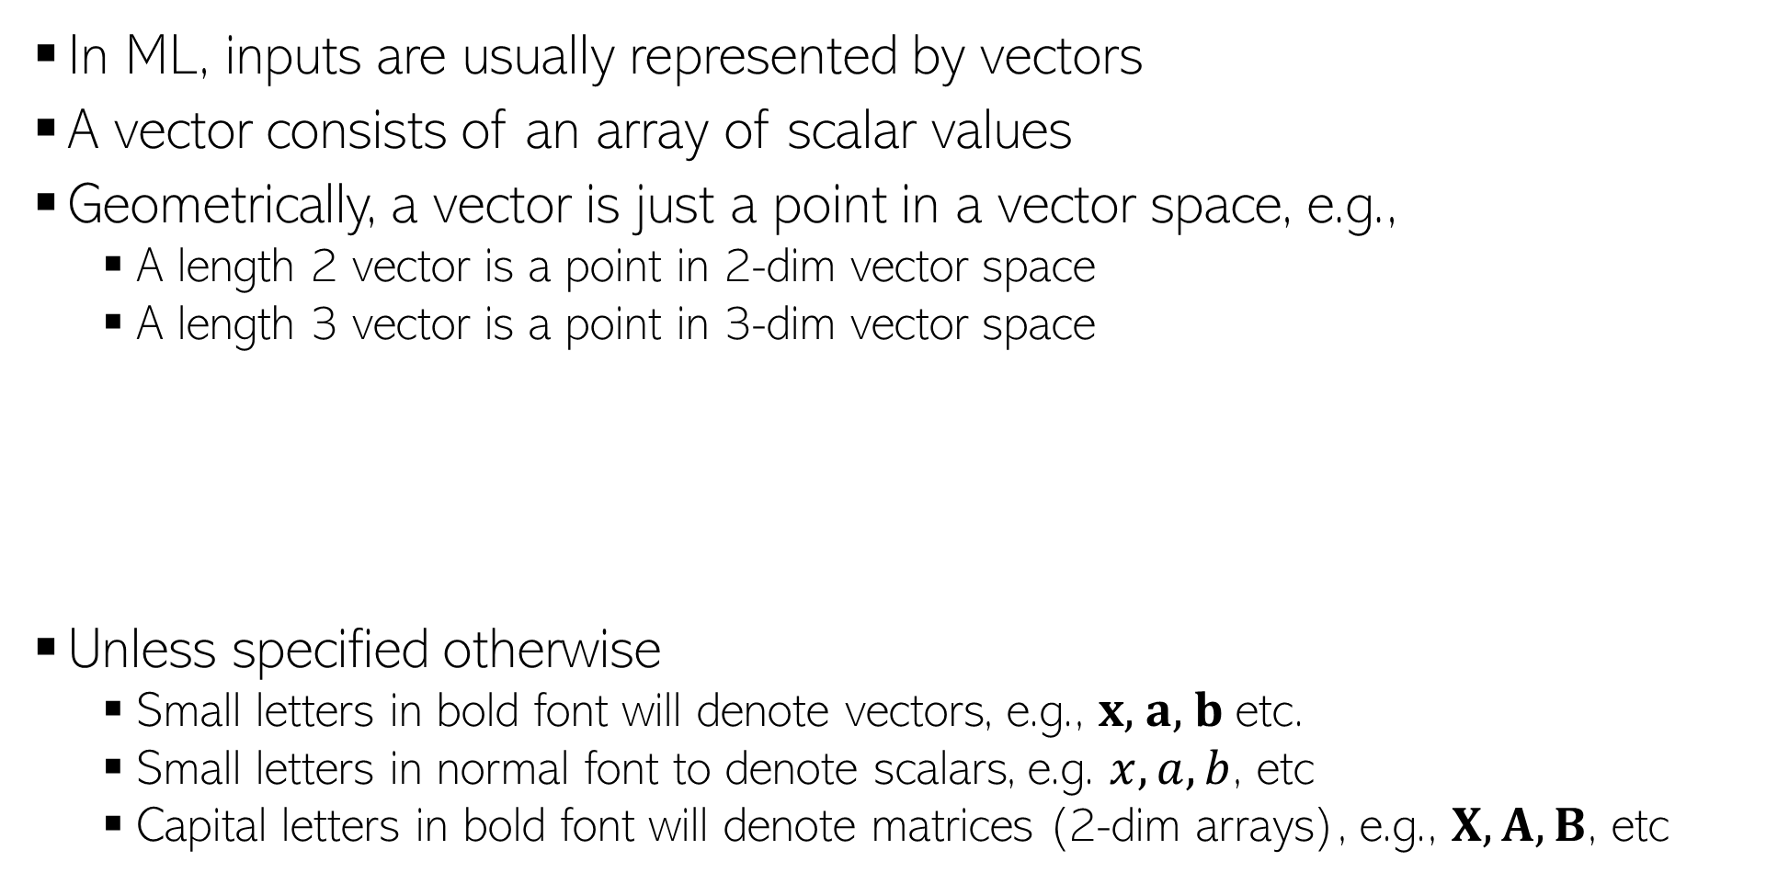
Some Notation and Conventions
In ML, inputs are usually represented by vectors
A vector consists of an array of scalar values
Geometrically, a vector is just a point in a vector space, e.g.,
A length 2 vector is a point in 2-dim vector space
A length 3 vector is a point in 3-dim vector space
Unless specified otherwise
Small letters in bold font will denote vectors, e.g., $x$, $a$, $b$ etc.
Small letters in normal font to denote scalars, e.g. $x, a, b$, etc
Capital letters in bold font will denote matrices (2-dim arrays), e.g., $X, A, B$, etc
0.5 | 0.3 | 0.6 | 0.1 | 0.2 | 0.5 | 0.9 | 0.2 | 0.1 | 0.5
Likewise for higher dimensions, even though harder to visualize
(0.5,0.3)
(0.5,0.3,0.6)
0.5 | 0.3 | 0.6
0.5 | 0.3

Slide 5
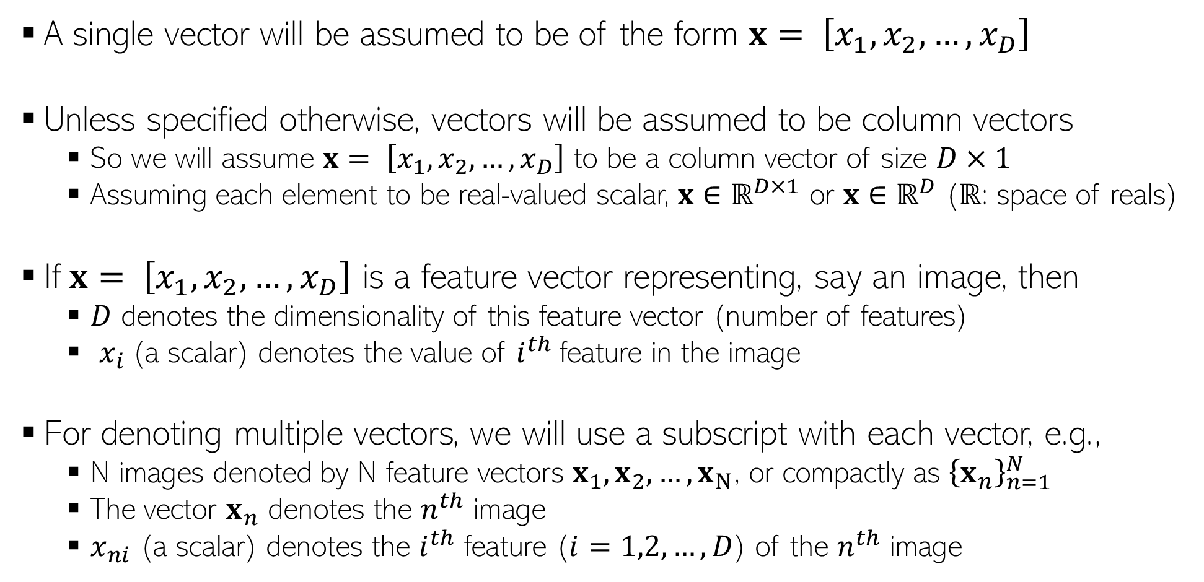
Some Notation and Conventions
A single vector will be assumed to be of the form $x= \left[x_{1},x_{2},…,x_{D}\right]$
Unless specified otherwise, vectors will be assumed to be column vectors
So we will assume $x= \left[x_{1},x_{2},…,x_{D}\right]$ to be a column vector of size $D×1$
Assuming each element to be real-valued scalar, $x$ $∈ℝ^{D×1}$ or $x$ $∈ℝ^{D}$ ($ℝ$: space of reals)
If$x= \left[x_{1},x_{2},…,x_{D}\right]$ is a feature vector representing, say an image, then
$D$ denotes the dimensionality of this feature vector (number of features)
$x_{i}$(a scalar) denotes the value of $i^{th}$feature in the image
For denoting multiple vectors, we will use a subscript with each vector, e.g.,
N images denoted by N feature vectors $x_{1}, x_{2},…,x_{N}$, or compactly as ${\left\{x_{n}\right\}}_{n=1}^{N}$
The vector $x_{n}$ denotes the $n^{th}$ image
$x_{ni}$ (a scalar) denotes the $i^{th}$ feature ($i=1,2,…,D$) of the $n^{th}$ image

Slide 6
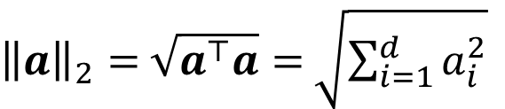
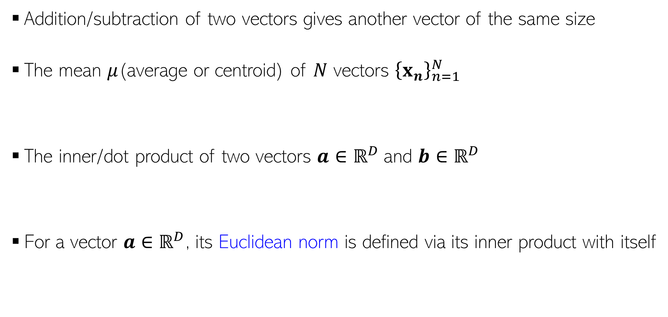
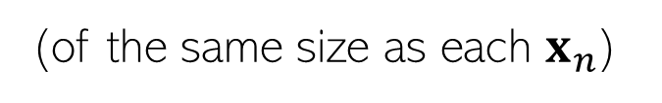
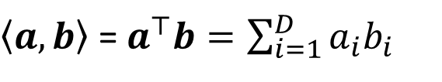

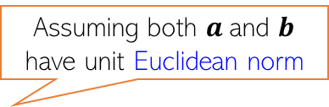
Some Basic Operations on Vectors
Addition/subtraction of two vectors gives another vector of the same size
The mean $μ$(average or centroid) of $N$ vectors ${\left\{x_{n}\right\}}_{n=1}^{N}$
The inner/dot product of two vectors $a$ $∈ℝ^{D}$and $b$ $∈ℝ^{D}$
For a vector $a$ $∈ℝ^{D}$, its Euclidean norm is defined via its inner product with itself
$$μ= \frac{1}{N}\sum_{n=1}^{N}{x_{n}}$$
(of the same size as each $x_{n}$)
Assuming both $a$and $b$ have unit Euclidean norm
$\left\langle a,b\right\rangle$ = $a^{⊤}b=\sum_{i=1}^{D}{a_{i}b_{i}}$
(a real-valued number denoting how “similar” $a$and $b$are)
${\left\|a\right\|}_{2}=$ $\sqrt{a^{⊤}a}=$ $\sqrt{\sum_{i=1}^{d}{a_{i}^{2}}}$

Slide 7

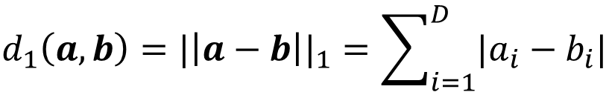
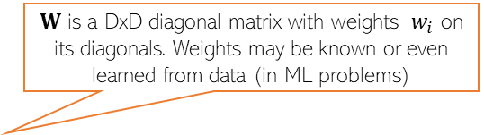
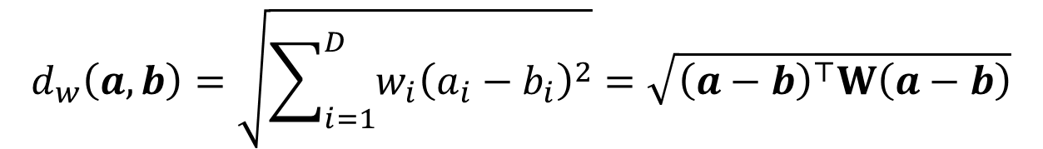
Computing Distances
Euclidean (L2 norm) distance between two vectors $a$ $∈ℝ^{D}$and $b$ $∈ℝ^{D}$
Weighted Euclidean distance between two vectors $a$ $∈ℝ^{D}$and $b$ $∈ℝ^{D}$
Absolute (L1 norm) distance between two vectors $a$ $∈ℝ^{D}$and $b$ $∈ℝ^{D}$
Sqrt of Inner product of the difference vector
Another expression in terms of inner products of individual vectors
$$d_{2}\left(a,b\right)={|\left|a−b\right||}_{2}=\sqrt{\sum_{i=1}^{D}{{\left(a_{i}−b_{i}\right)}^{2}}}=\sqrt{{\left(a−b\right)}^{⊤}\left(a−b\right)}=\sqrt{a^{⊤}a+b^{⊤}b−2a^{⊤}b}$$
$W$ is a DxD diagonal matrix with weights $w_{i}$ on its diagonals. Weights may be known or even learned from data (in ML problems)
$$d_{w}\left(a,b\right)=\sqrt{\sum_{i=1}^{D}{{w_{i}\left(a_{i}−b_{i}\right)}^{2}}}=\sqrt{{\left(a−b\right)}^{⊤}W\left(a−b\right)}$$
L1 norm distance is also known as the Manhattan distance or Taxicab norm
(it’s a very natural notion of distance between two points in some vector space)
$$d_{1}\left(a,b\right)={|\left|a−b\right||}_{1}=\sum_{i=1}^{D}{|a_{i}−b_{i}|}$$

Slide 8
Our First Supervised Learner

Slide 9




Prelude: A Very Primitive Classifier
The idea also applies to multi-class classification: Use one image per class, and predict label based on the distances of the test image from all such images
Consider a binary classification problem – cat vs dog
Assume training data with just 2 images – one and one
Given a new test image (cat/dog), how do we predict its label?
A simple idea: Predict using its distance from each of the 2 training images
d( , ) < d( , ) ? Predict cat else dog
Test
image
Test
image
Wait. Is it ML? Seems to be like just a simple “rule”. Where is the “learning” part in this?
Some possibilities: Use a feature learning/selection algorithm to extract features, and use a Mahalanobis distance where you learn the W matrix (instead of using a predefined W), using “distance metric learning” techniques
Even this simple model can be learned. For example, for the feature extraction/selection part and/or for the distance computation part

Slide 10
Improving Our Primitive Classifier
Just one input per class may not sufficiently capture variations in a class
A natural improvement can be by using more inputs per class
We will consider two approaches to do this
Learning with Prototypes (LwP)
Nearest Neighbors (NN)
Both LwP and NN will use multiple inputs per class but in different ways
“cat”
“dog”
“cat”
“dog”
“cat”
“dog”

Slide 11
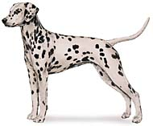
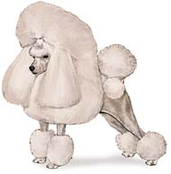



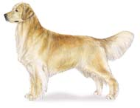
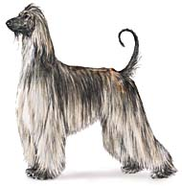

Learning to predict categories
dog
dog
??
cat
dog
cat
dog
cat

Slide 12
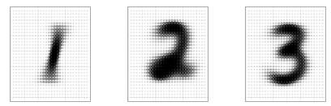
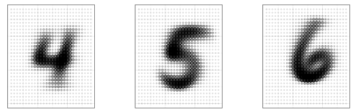
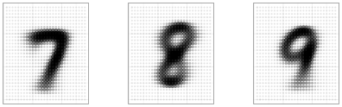
Learning with Prototypes (LwP)
Basic idea: Represent each class by a “prototype” vector
Class Prototype: The “mean” or “average” of inputs from that class
Predict label of each test input based on its distances from the class prototypes
Predicted label will be the class that is the closest to the test input
How we compute distances can have an effect on the accuracy of this model (may need to try Euclidean, weight Euclidean, Mahalanobis, or something else)
Averages (prototypes) of each of the handwritten digits 1-9
Pic from: https://www.reddit.com/r/dataisbeautiful/comments/3wgbv9/average_handwritten_digit_oc/

Slide 13





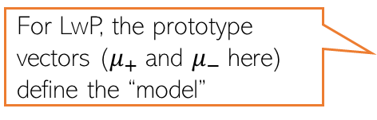
Learning with Prototypes (LwP): An Illustration
Suppose the task is binary classification (two classes assumed pos and neg)
Training data: $N$ labelled examples ${\{\left(x_{n},y_{n}\right)\}}_{n=1}^{N}$,${ x}_{n}∈ℝ^{D}$, ${ y}_{n} ∈\{−1,+1\}$
Assume $N_{+}$ example from positive class, $N_{−}$ examples from negative class
Assume green is positive and red is negative
$$μ_{−}= \frac{1}{N_{−}}\sum_{y_{n}=−1}{x_{n}}$$
$$μ_{+}= \frac{1}{N_{+}}\sum_{y_{n}=+1}{x_{n}}$$
$$μ_{−}$$
$$μ_{+}$$
LwP straightforwardly generalizes to more than 2 classes as well (multi-class classification) – K prototypes for K classes
For LwP, the prototype vectors ($μ_{+}$and $μ_{−}$here) define the “model”
Test example
Test example

Slide 14



LwP: The Prediction Rule, Mathematically
What does the prediction rule for LwP look like mathematically?
Assume we are using Euclidean distances here
$${\left|\left|μ_{−}−x\right|\right|}^{2}={\left|\left|μ_{−}\right|\right|}^{2}+{\left|\left|x\right|\right|}^{2}−2\left\langle μ_{−},x\right\rangle$$
$$μ_{−}$$
$$μ_{+}$$
$${\left|\left|μ_{+}−x\right|\right|}^{2}={\left|\left|μ_{+}\right|\right|}^{2}+{\left|\left|x\right|\right|}^{2}−2\left\langle μ_{+},x\right\rangle$$
Test example $x$
Prediction Rule: Predict label as +1 if $f\left(x\right)={\left|\left|μ_{−}−x\right|\right|}^{2}$ $−$ ${\left|\left|μ_{+}−x\right|\right|}^{2}>0$ otherwise -1

Slide 15

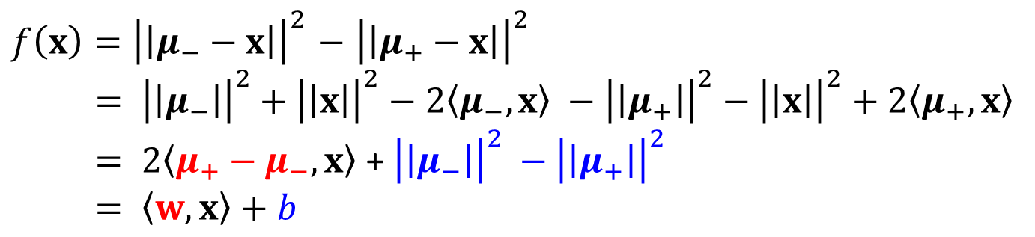
LwP: The Prediction Rule, Mathematically
Let’s expand the prediction rule expression a bit more
Thus LwP with Euclidean distance is equivalent to a linear model with
Weight vector $w=$2($μ_{+}−μ_{−})$
Bias term $b={\left|\left|μ_{−}\right|\right|}^{2} −{\left|\left|μ_{+}\right|\right|}^{2}$
Prediction rule therefore is: Predict +1 if $\left\langle w,x\right\rangle +b$ > 0, else predict -1
$f\left(x\right)={\left|\left|μ_{−}−x\right|\right|}^{2}$ $−$ ${\left|\left|μ_{+}−x\right|\right|}^{2}$
$= {\left|\left|μ_{−}\right|\right|}^{2}+{\left|\left|x\right|\right|}^{2}−2\left\langle μ_{−},x\right\rangle −{\left|\left|μ_{+}\right|\right|}^{2}−{\left|\left|x\right|\right|}^{2}+2\left\langle μ_{+},x\right\rangle$
$= 2\left\langle μ_{+}−μ_{−},x\right\rangle$ + ${\left|\left|μ_{−}\right|\right|}^{2} −{\left|\left|μ_{+}\right|\right|}^{2}$
$= \left\langle w,x\right\rangle +b$
Will look at linear models more formally and in more detail later

Slide 16



LwP: Some Failure Cases
Here is a case where LwP with Euclidean distance may not work well
In general, if classes are not equisized and spherical, LwP with Euclidean distance will usually not work well (but improvements possible; will discuss later)
Can use feature scaling or use Mahalanobis distance to handle such cases (will discuss this in the next lecture)
$$μ_{−}$$
$$μ_{+}$$
Test example $x$

Slide 17
LwP: Some Key Aspects
Very simple, interpretable, and lightweight model
Just requires computing and storing the class prototype vectors
Works with any number of classes (thus for multi-class classification as well)
Can be generalized in various ways to improve it further, e.g.,
Modeling each class by a probability distribution rather than just a prototype vector
Using distances other than the standard Euclidean distance (e.g., Mahalanobis)
With a learned distance function, can work very well even with very few examples from each class (used in some “few-shot learning” models nowadays – if interested, please refer to “Prototypical Networks for Few-shot Learning”)
How well LwP works depends crucially on the way we compute distances

Slide 18



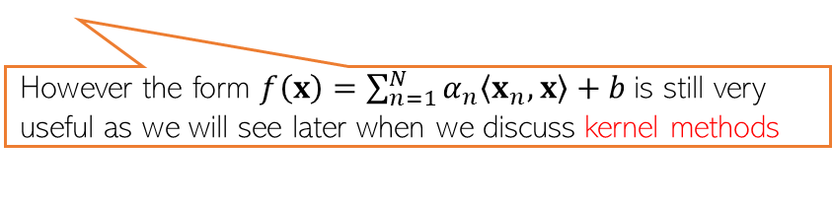


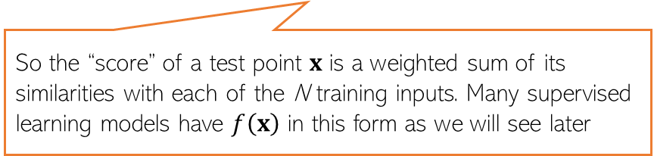
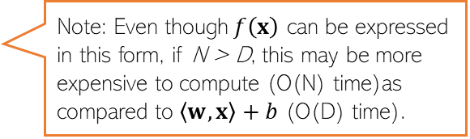


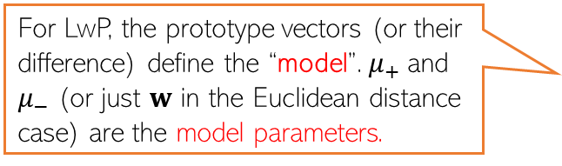
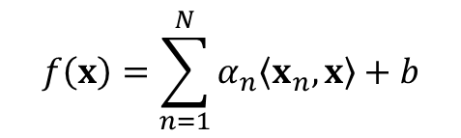
Learning with Prototypes (LwP)
$$μ_{−}= \frac{1}{N_{−}}\sum_{y_{n}=−1}{x_{n}}$$
$$μ_{+}= \frac{1}{N_{+}}\sum_{y_{n}=+1}{x_{n}}$$
$$μ_{−}$$
$$μ_{+}$$
$$w$$
$$w=μ_{+} −μ_{−}$$
Prediction rule for LwP (for binary classification with Euclidean distance)
If Euclidean distance used
$f\left(x\right)= 2\left\langle μ_{+}−μ_{−},x\right\rangle$ + ${\left|\left|μ_{−}\right|\right|}^{2} −{\left|\left|μ_{+}\right|\right|}^{2}= \left\langle w,x\right\rangle +b$
For LwP, the prototype vectors (or their difference) define the “model”. $μ_{+}$and $μ_{−}$ (or just $w$ in the Euclidean distance case) are the model parameters.
Decision boundary
(perpendicular bisector of line joining the class prototype vectors)
($f\left(x\right)$> 0 then predict +1 otherwise -1)
Exercise: Show that for the bin. classfn case
$$f\left(x\right)=\sum_{n=1}^{N}{α_{n}\left\langle x_{n},x\right\rangle +b}$$
Note: Even though$f\left(x\right)$ can be expressed in this form, if N > D, this may be more expensive to compute (O(N) time)as compared to $\left\langle w,x\right\rangle +b$ (O(D) time).
Can throw away training data after computing the prototypes and just need to keep the model parameters for the test time in such “parametric” models
So the “score” of a test point $x$ is a weighted sum of its similarities with each of the N training inputs. Many supervised learning models have $f\left(x\right)$ in this form as we will see later
However the form $f\left(x\right)=\sum_{n=1}^{N}{α_{n}\left\langle x_{n},x\right\rangle +b}$is still very useful as we will see later when we discuss kernel methods

Slide 19



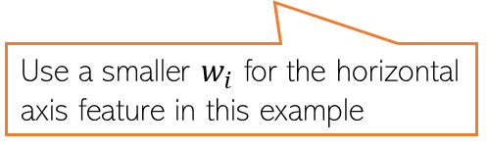
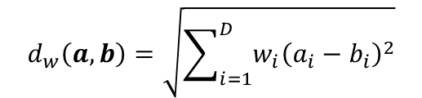



Improving LwP when classes are complex-shaped
Using weighted Euclidean or Mahalanobis distance can sometimes help
Note: Mahalanobis distance also has the effect of rotating the axes which helps
$$μ_{+}$$
$$d_{w}\left(a,b\right)=\sqrt{\sum_{i=1}^{D}{{w_{i}\left(a_{i}−b_{i}\right)}^{2}}}$$
$$μ_{−}$$
Use a smaller $w_{i}$ for the horizontal axis feature in this example
A good W will help bring points from same class closer and move different classes apart
W will be a 2x2 symmetric matrix in this case (chosen by us or learned)
$$μ_{−}$$
$$d_{w}\left(a,b\right)=\sqrt{{\left(a−b\right)}^{⊤}W\left(a−b\right)}$$
$$μ_{+}$$
$$μ_{+}$$
$$μ_{−}$$

Slide 20
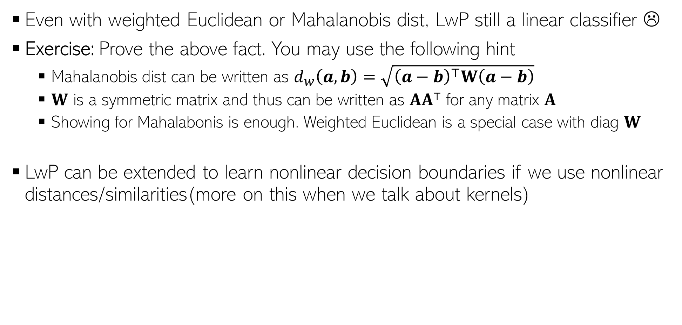
Improving LwP when classes are complex-shaped
Even with weighted Euclidean or Mahalanobis dist, LwP still a linear classifier ☹
Exercise: Prove the above fact. You may use the following hint
Mahalanobis dist can be written as $d_{w}\left(a,b\right)=\sqrt{{\left(a−b\right)}^{⊤}W\left(a−b\right)}$
$W$ is a symmetric matrix and thus can be written as $AA⊤$ for any matrix $A$
Showing for Mahalabonis is enough. Weighted Euclidean is a special case with diag $W$
LwP can be extended to learn nonlinear decision boundaries if we use nonlinear distances/similarities(more on this when we talk about kernels)
Note: Modeling each class by not just a mean by a probability distribution can also help in learning nonlinear decision boundaries. More on this when we discuss probabilistic models for classification

Slide 21
LwP as a subroutine in other ML models
For data-clustering (unsupervised learning), K-means clustering is a popular algo
K-means also computes means/centres/prototypes of groups of unlabeled points
Harder than LwP since labels are unknown. But we can do the following
Guess the label of each point, compute means using guess labels
Refine labels using these means (assign each point to the current closest mean)
Repeat until means don’t change anymore
Many other models also use LwP as a subroutine
Will see K-means in detail later

Slide 22
Next Lecture
Nearest Neighbors

